Slide 1
MVS Nanotransistor models 1.1.1(Silicon) and 2.0
Presentation By
Saurav Thakur

Slide 2
Preface
Si-MVS model is semi empirical approach to the I-V characteristics of small channel MOSFETs(quasiballistic regime) where traditional calculation doesn’t work. The model also gives intrinsic charges with only few parameters
MVS 2.0.0 model inculcates the degeneracy in thermal velocity and mean free path. This model considers effect of drain bias on the gate capacitance. The model is compared with ETSOI and HEMT (InGaAs) using some empirical parameters

Slide 3
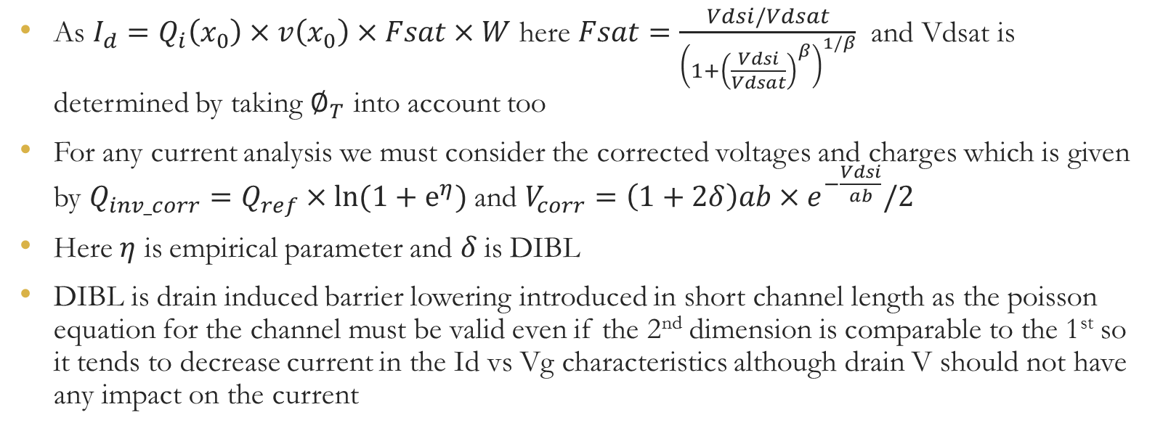
Si-MVS Model
As $I_{d}=Q_{i}\left(x_{0}\right)×v\left(x_{0}\right)×Fsat×W$ here $Fsat=\frac{Vdsi/Vdsat}{{\left(1+{\left(\frac{Vdsi}{Vdsat}\right)}^{β}\right)}^{1/β}}$ and Vdsat is determined by taking $∅_{T}$ into account too
For any current analysis we must consider the corrected voltages and charges which is given by $Q_{inv_corr}=Q_{ref}×ln⁡(1+e^{η})$ and $V_{corr}=\left(1+2δ\right)ab×e^{−\frac{Vdsi}{ab}}/2$
Here $η$ is empirical parameter and $δ$is DIBL
DIBL is drain induced barrier lowering introduced in short channel length as the poisson equation for the channel must be valid even if the 2nd dimension is comparable to the 1st so it tends to decrease current in the Id vs Vg characteristics although drain V should not have any impact on the current

Slide 4
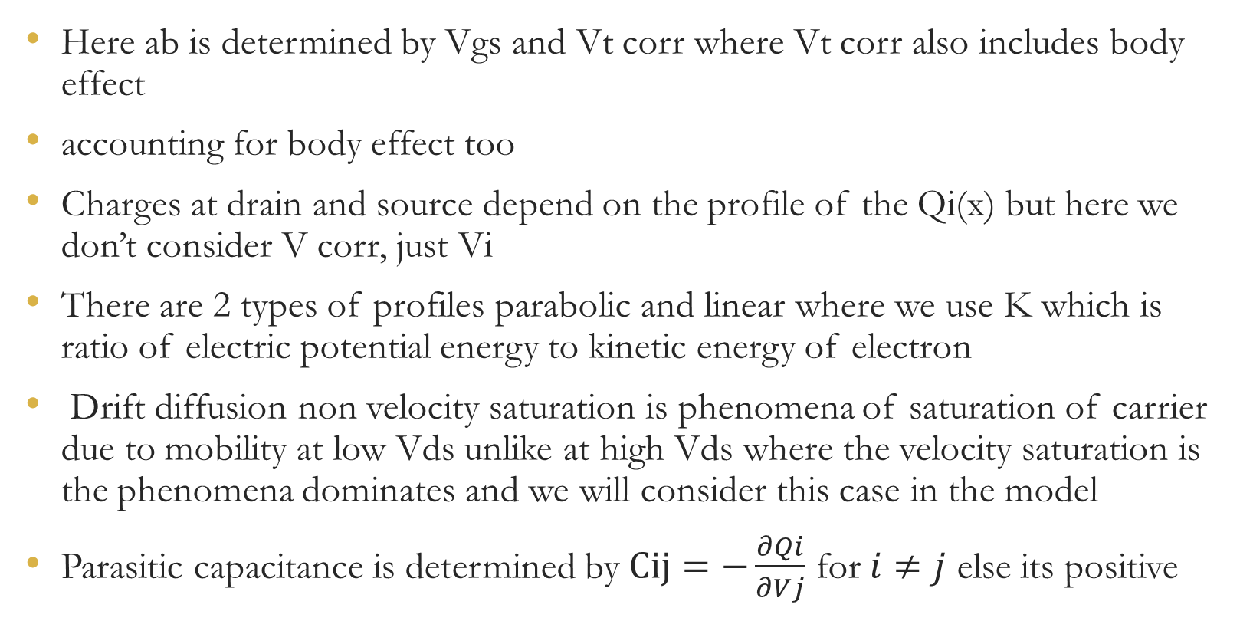
Here ab is determined by Vgs and Vt corr where Vt corr also includes body effect
accounting for body effect too
Charges at drain and source depend on the profile of the Qi(x) but here we don’t consider V corr, just Vi
There are 2 types of profiles parabolic and linear where we use K which is ratio of electric potential energy to kinetic energy of electron
Drift diffusion non velocity saturation is phenomena of saturation of carrier due to mobility at low Vds unlike at high Vds where the velocity saturation is the phenomena dominates and we will consider this case in the model
Parasitic capacitance is determined by $Cij=−\frac{∂Qi}{∂Vj}$ for $i≠j$ else its positive

Slide 5
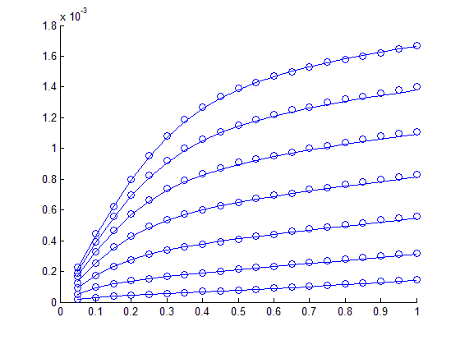
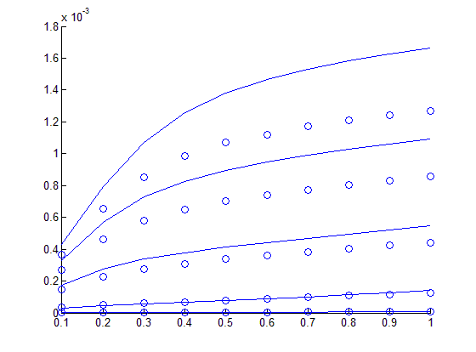
Interpretation of Outputs
Channel length=32nm
Channel length=45nm
Id(A)
As the current follows Vds exponentially for small Vds and then it tends to reach saturation although the slope after saturation is proportional to Vds
Id(A)
Vds (V)
Vds (V)
It is evident that channel length is decreased too much then due to quasi ballistic regime its current is higher for same Vds and Vgs

Slide 6
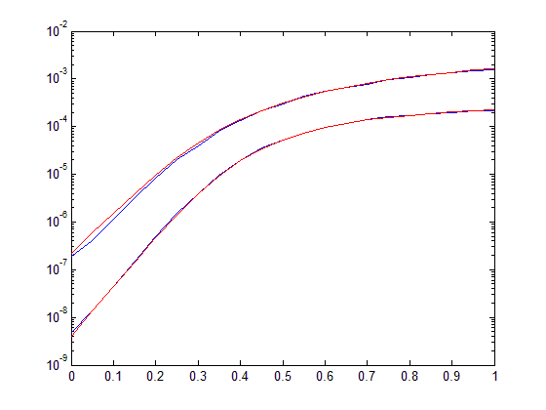
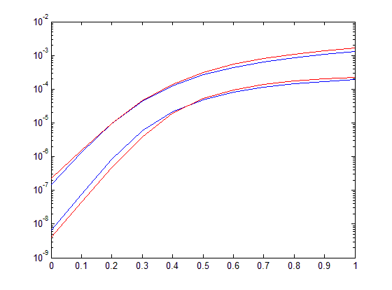
Channel length=32nm
Channel length=45nm
Id(A)
Id(A)
Vgs(V)
Vgs(V)
Vds is increased from 0.5V to 1V and it is visible that the slope of the lower Vg is reduced. This is due to subthreshold swing as the channel length is small
Although Vds is increased from 0.5V to 1V but the slope of the lower Vg is still the same which means there is almost no subthreshold swing for this channel length

Slide 7
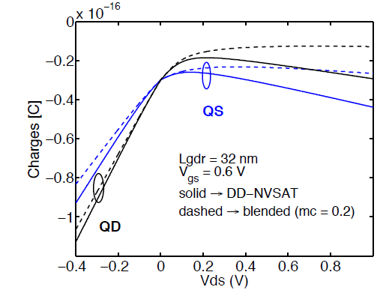
Charge Variation with Vds
For the linear regime charges(both drain and source) follow linearity but after saturation the mobility actually decreases as the collision and scattering increases thus the charge on the terminals starts to decrease
Image source-Silicon MIT Virtual Source Model by S. Rakheja

Slide 8
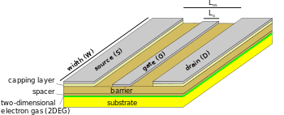



HEMT Devices
High Electron Mobility Transistors
HEMT is a heterojunction device which has high current carrying capacity
2 different materials with dissimilar energy band gaps form a junction
Due to heterojunction we have abrupt change in Energy band at the junction and it goes even below the fermi level hence it has large number of available electrons
Image source-Wikipedia.org
$$E_{c1}$$
$$E_{c2}$$
$$E_{F}$$

Slide 9
ETSOI Devices
Extremely thin silicon on insulator devices have extremely thin channel length and has 2 gates
Due to small size we have to consider the sub-bands too as electrons can exists only in quantum states which can be calculated with quantum mechanics if we know the potential well
Gate
Silicon
Oxide layer

Slide 10

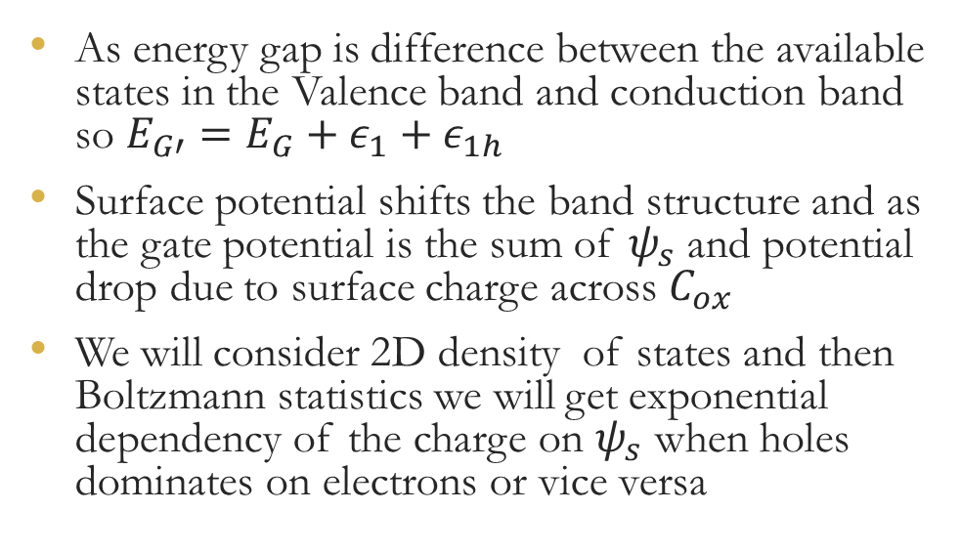
Charge carrier density for ETSOI
As energy gap is difference between the available states in the Valence band and conduction band so $E_{G′}=E_{G}+ε_{1}+ε_{1h}$
Surface potential shifts the band structure and as the gate potential is the sum of $ψ_{s}$ and potential drop due to surface charge across $C_{ox}$
We will consider 2D density of states and then Boltzmann statistics we will get exponential dependency of the charge on $ψ_{s}$ when holes dominates on electrons or vice versa
Ln(Q)
Almost linear
Almost linear
Negligible
$$ψ_{s}$$

Slide 11
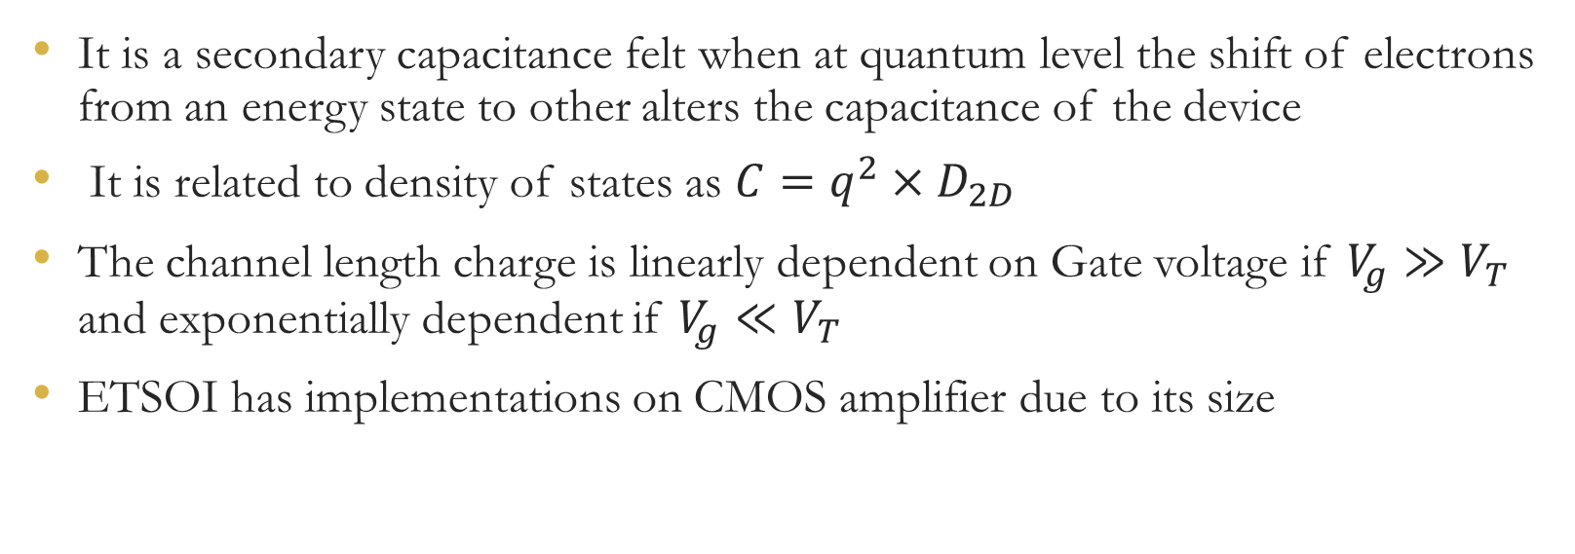
It is a secondary capacitance felt when at quantum level the shift of electrons from an energy state to other alters the capacitance of the device
It is related to density of states as $C=q^{2}×D_{2D}$
The channel length charge is linearly dependent on Gate voltage if $V_{g}≫V_{T}$ and exponentially dependent if $V_{g}≪V_{T}$
ETSOI has implementations on CMOS amplifier due to its size

Slide 12
MVS 2.0.0 Model
It is semi empirical model to approximate the ETSOI and HMET
This model consider degeneracy in thermal velocity and mean free path i.e. as in HEMT the Fermi gas(electrons at very high energy) the velocity is degenerate and for ballistic limits the mean free path is degenerate
This model considers effect of drain bias on the gate capacitance
We also consider transmission that can be said as the probability of the charge carrier which crosses VS reaches to drain. In ballistic limit Transmission is 1 as at that scale scattering doesn’t occurs

Slide 13
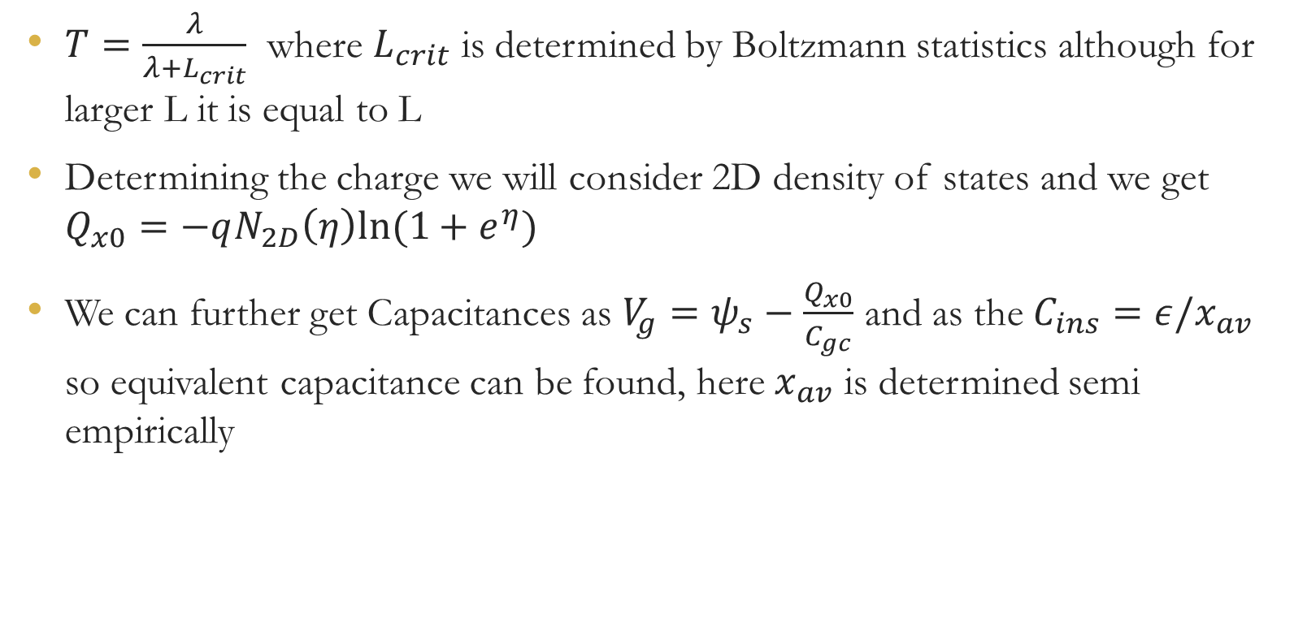
$T=\frac{λ}{λ+L_{crit}}$ where $L_{crit}$ is determined by Boltzmann statistics although for larger L it is equal to L
Determining the charge we will consider 2D density of states and we get $Q_{x0}=−qN_{2D}\left(η\right)ln⁡(1+e^{η})$
We can further get Capacitances as $V_{g}=ψ_{s}−\frac{Q_{x0}}{C_{gc}}$ and as the $C_{ins}=ε/x_{av}$ so equivalent capacitance can be found, here $x_{av}$ is determined semi empirically

Slide 14
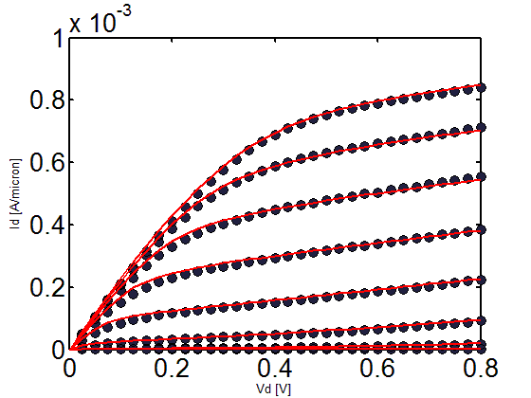
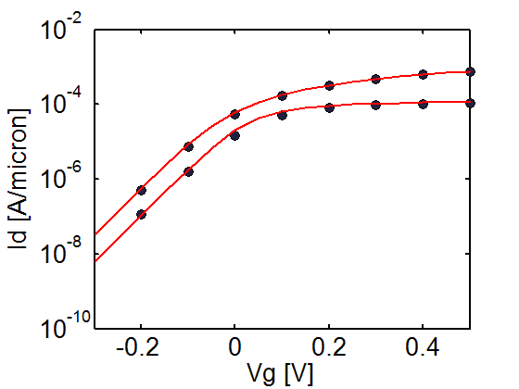
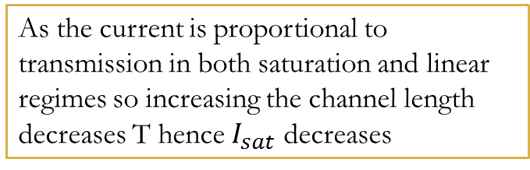
Interpretation of Graphs for HEMT
Channel length 30nm
As the current is proportional to transmission in both saturation and linear regimes so increasing the channel length decreases T hence $I_{sat}$ decreases
The behavior of current in HEMT is similar to the silicon MOSFETs although there is very small DIBL observed at any lengths

Slide 15
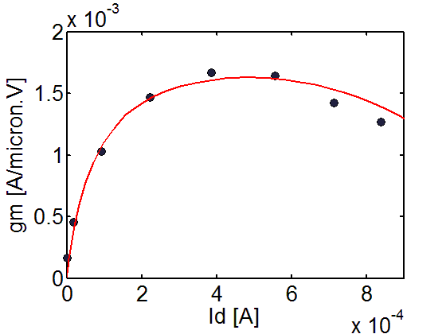

$G_{m}$ vs $I_{d}$ for HEMT
First the conductivity increases as the current increases before reaching saturation
The conductivity then decreases after the saturation of mobility due to increase in scattering

Slide 16
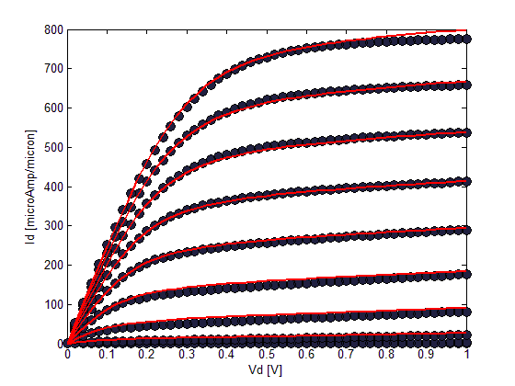
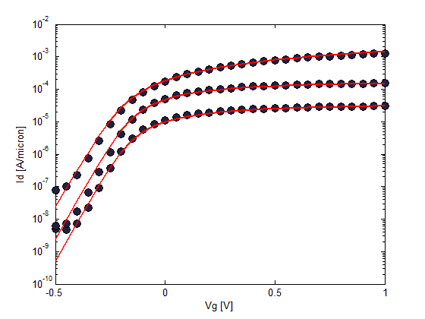
Interpretation of Graphs of ETSOI
The channel length 40nm
The model shows high DIBL for shorter length
It shows that saturation current is less dependent on Vds. The current decreases with increase in length

Slide 17
THANK YOU

